Slide 1
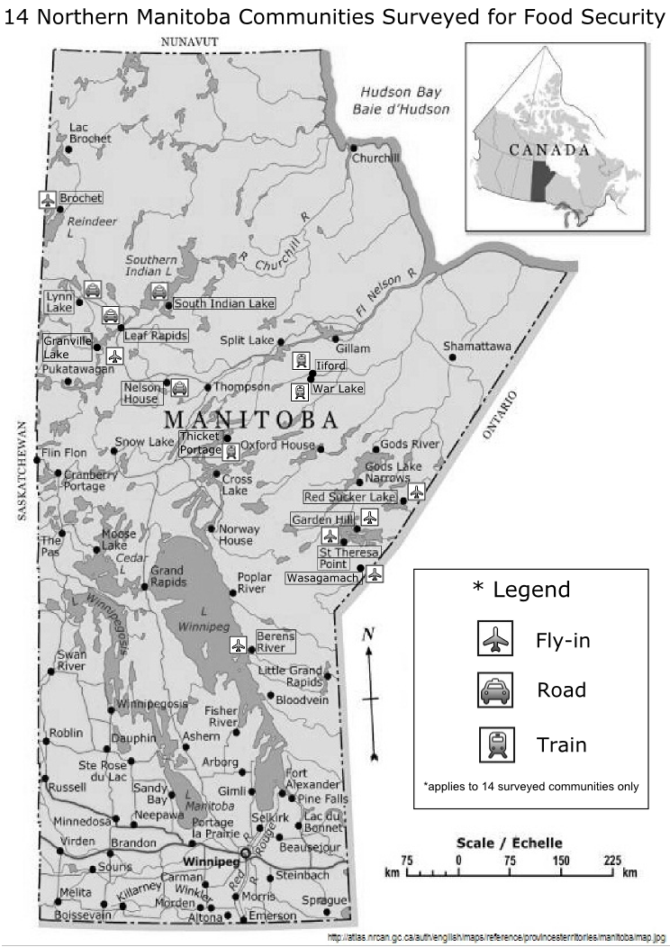
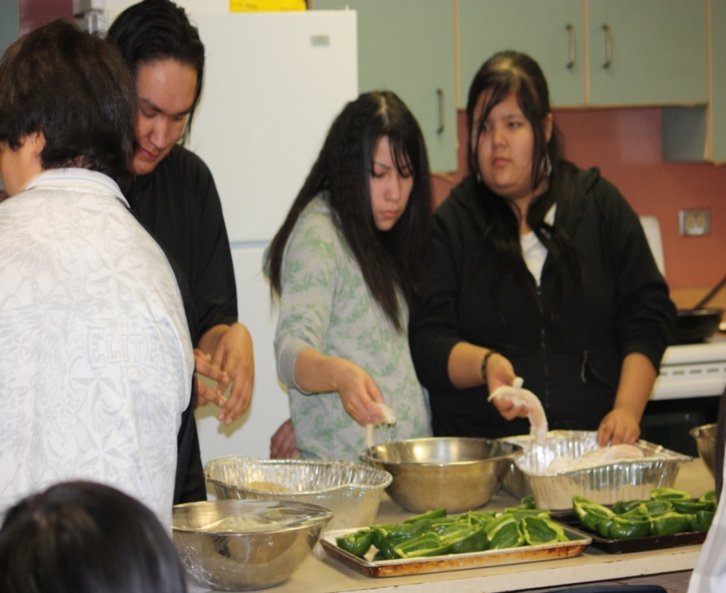
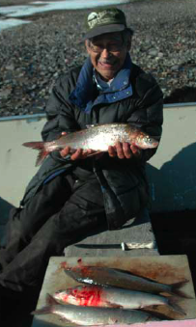
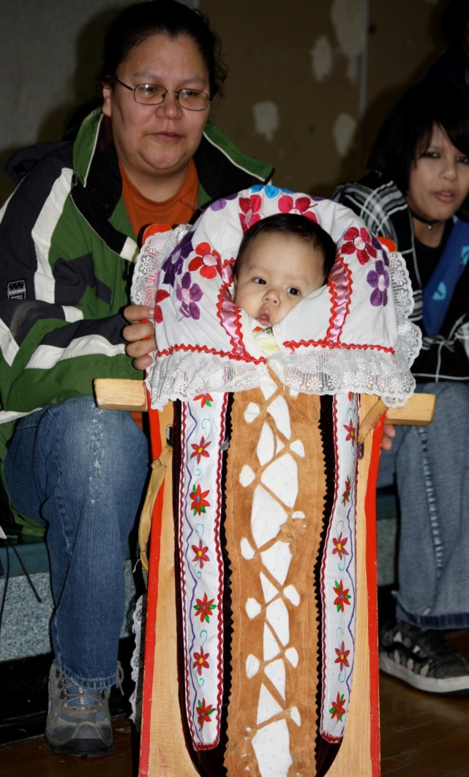
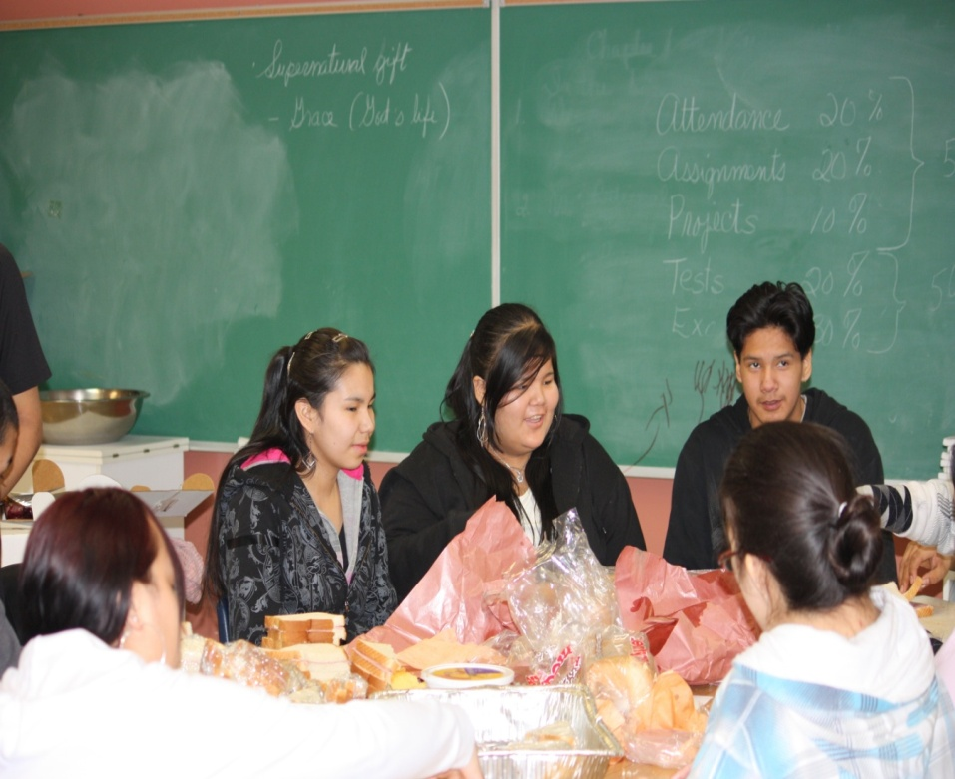
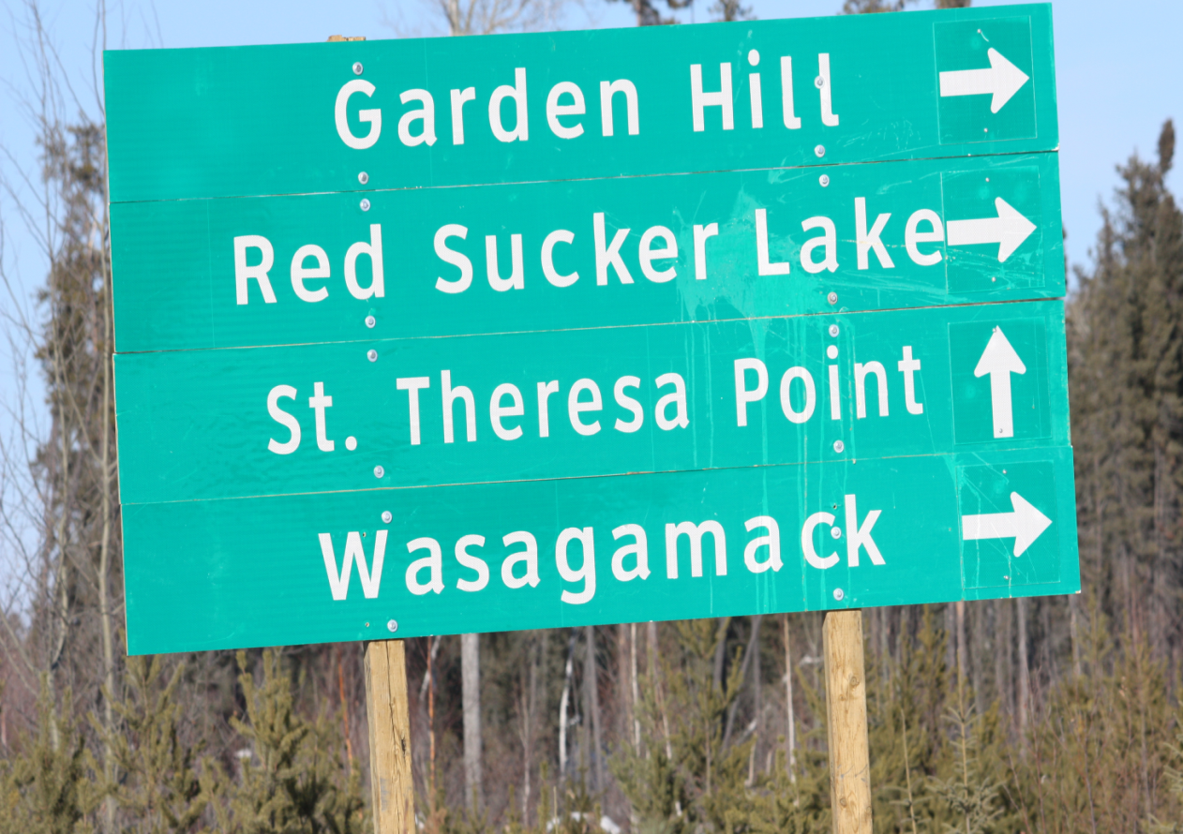
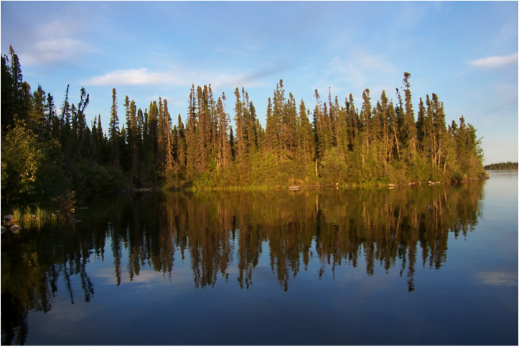
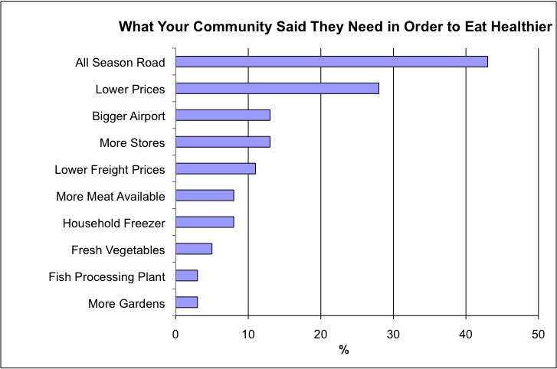
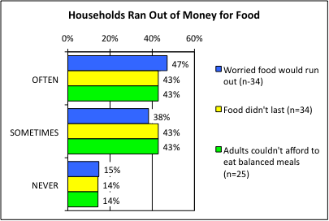
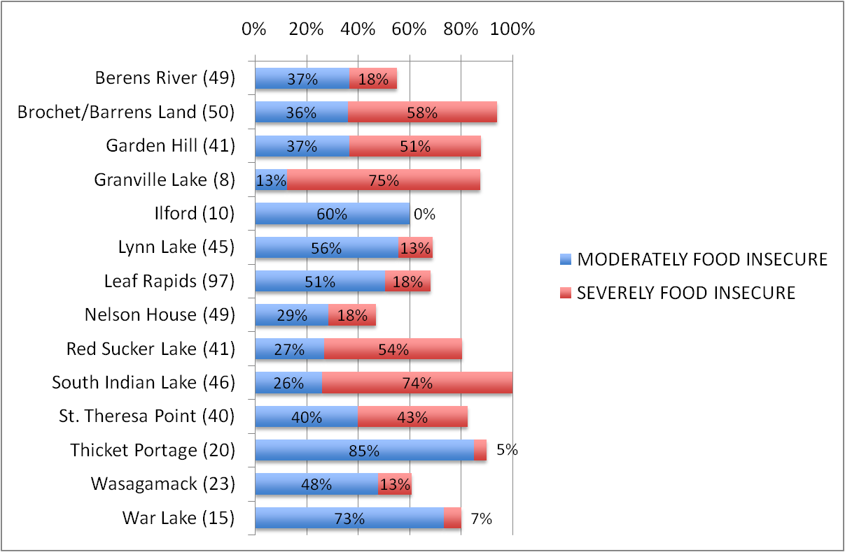
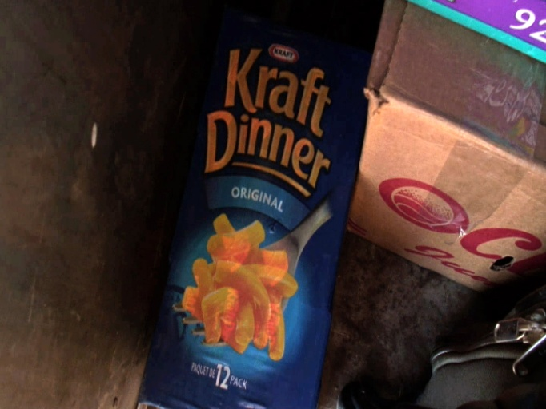
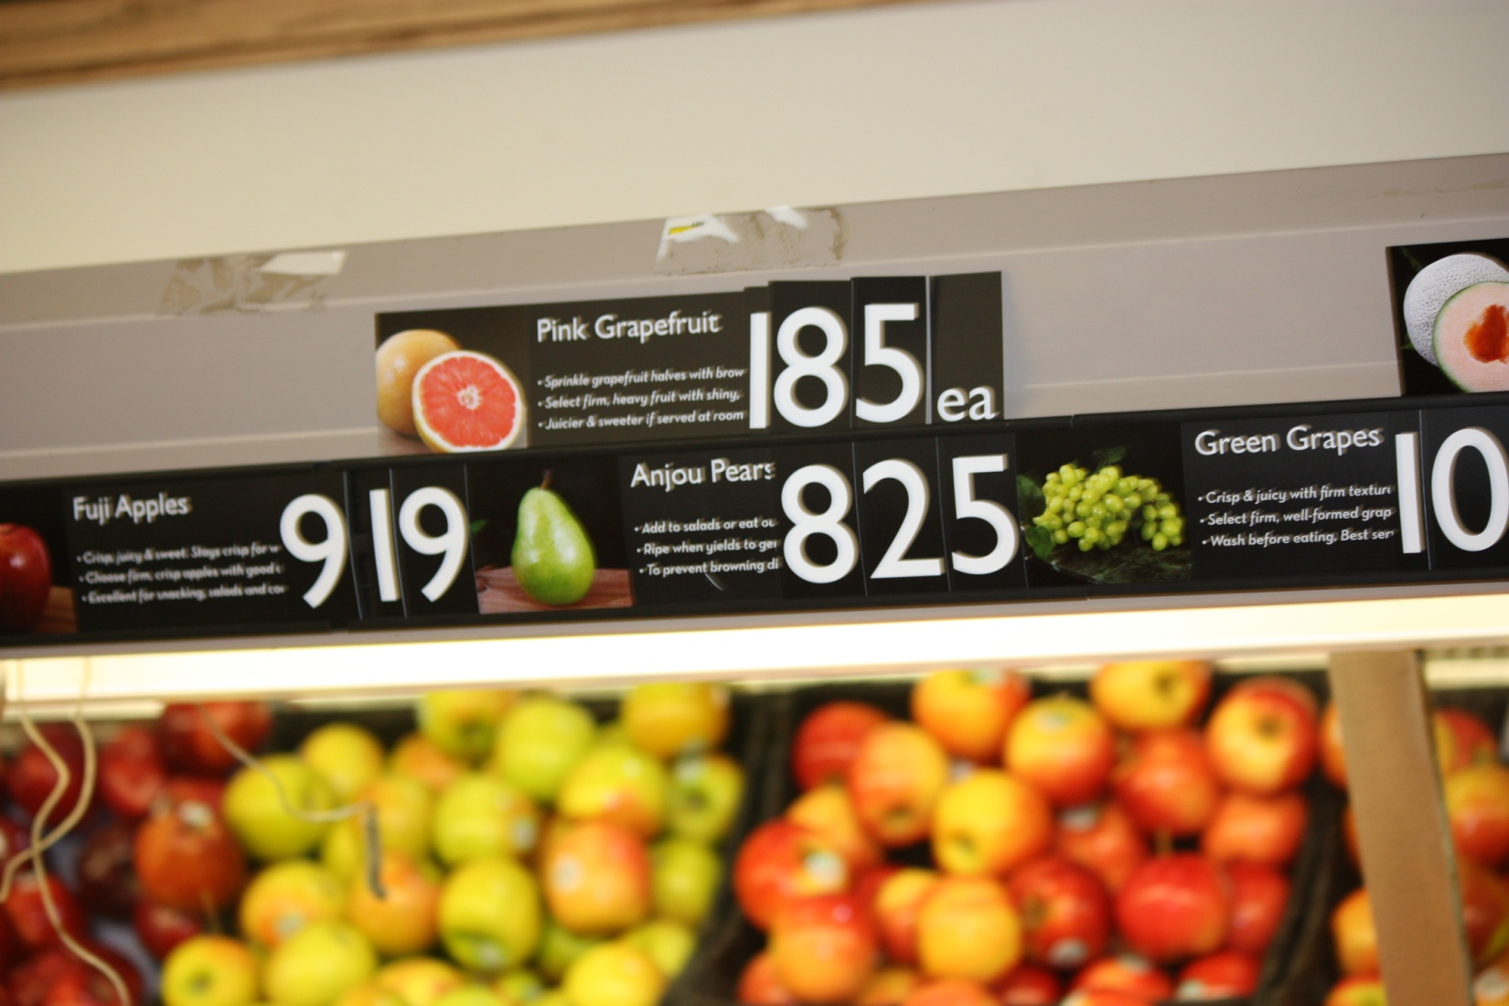
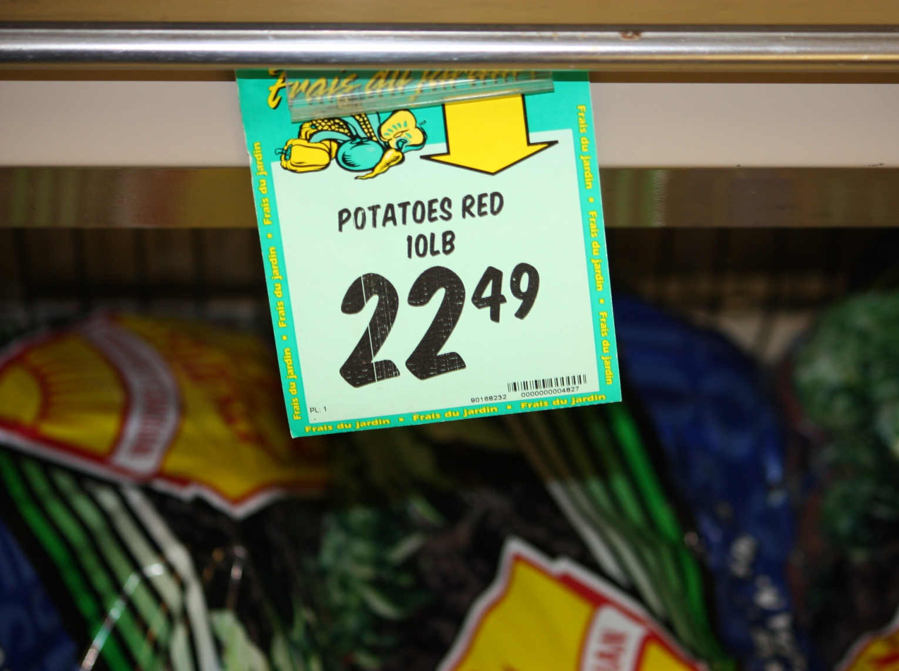
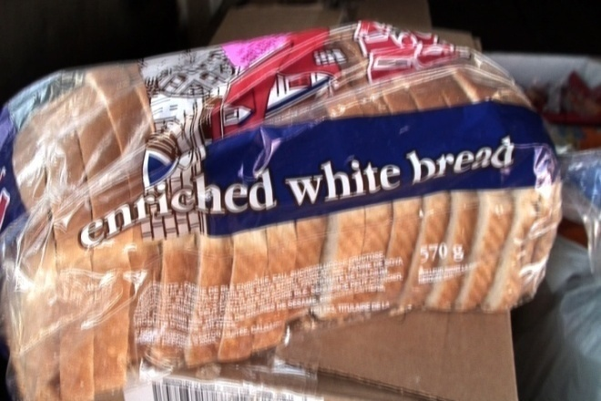
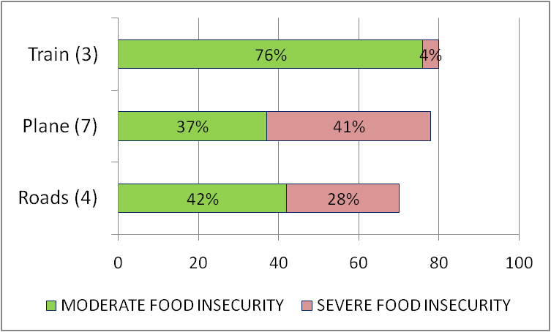
83% FOOD INSECURITY RATES IN ST. THERESA POINT FIRST NATION:
Market Food System in Fly-in Communities not Improving Food Security
Aruna Murthy Anaparti, Shauna Zahariuk, Shirley Thompson and Raghavender R. Geebu
Natural Resources Institute, University of Manitoba
s_thompson@cc.umanitoba.ca
“I wish I knew how to garden. I work hard to put food on the table”
St. Theresa Point First Nation
90% St. Theresa Point residents rely on country foods.
FINDINGS
The survey revealed that 90% of households either hunted or fished, or received some country foods from relatives. In these households country food varies from 10% to 95% of all foods consumed.
Four Arrows Regional Health Authority (FARHA) provides a freezer revolving loan which is part of why 93% of households had a freezer to store country foods, gardens to produce fresh fruits and vegetables and store-bought foods.
High food cost was found to be the largest barrier to eating healthy (63%).Lack of freshfood was another reason to prevent healthy eating (33%): many participants reported that produce was often wilted or rotten either at purchase time or shortly thereafter.
Many community members identified an all-season road (43%) as key to reduce the cost of foods, since people could drive to larger communities and goods could be transported into the community via long haul trucks and trailers (Figure 1).
Programming in schools for lunch was limited to macaroni and cheese and hotdogs due to limited funding and would benefit from the use of fish and other country foods. The public health officer threatens to shut down the school kitchen if they find country foods.
BACKGROUND
As St Theresa Point First Nation in Northern Manitoba is a fly-in community, all store bought food must be flown in, which limits food selection, particularly for fresh produce. This increases food prices and creates food insecurity. This food insecurity may be the reason why Manitoba has the highest rate of paediatric diabetes in North America⁴, particularly in Oji-Cree First Nation communities, such as St. Theresa Point First Nation. According to community interviews and physician reports, diabetes was unheard of in First Nation communities forty years ago.
In the past, these communities relied on country foods for sustenance and health. Country foods, such as wild meat and local fish, plants, berries and waterfowl/seabirds harvested from local stocks, alleviates hunger, promotes an active lifestyle and nourishes the soul with nutritious, culturally appropriate foods. However, currently public health restrictions due to prions and other risks prohibit selling wild game and ban free public distribution of country foods in hospitals and schools without processing at a federal food processor. But a federal food processor is not available in northern Manitoba.
The Canadian Community Health Survey 2.2; Nutrition Focus Study (CCHS 2.2) excluded First Nation reserves in its 2004 national study that found household food insecurity rates of 9.2% in the Canadian population¹. Extensive compromises in food selection and total food intake have been documented in conjunction with more severe levels of food insecurity^{2,3} and poverty¹. This study tries to fill in the knowledge gap regarding food security in St. Theresa Point First Nation.
Figure1. What Community Members Require To Eat Healthy
SUMMARY OF SURVEY RESULTS
47% households could not afford to eat and went hungry within the past year due to lack of money (Figure 2).
39% of children’s meals were skipped because there wasn’t enough money for food.
78% of households relied on a few kinds of low-cost foods to feed children due to lack of money.
81% of households could not afford to purchase healthy foods.
82% of adults ate less than they felt they should due to lack of money.
52% of adults went hungry because there was not enough food in the household due to lack of money.
36% of adults often and 36% of adults sometimes went without food for a whole day at least once per month due to lack of food and money to buy more.
28% of adults often and 61% of adults sometimes skipped meals due to lack of food and money.
Figure 2. Households worried money would run out (blue), money did run out (yellow), and they couldn’t afford healthy foods (green).
OBJECTIVES
To assess whether households go hungry or compromise quality of food due to lack of income.
To identify what community people need in order to improve access to healthy foods.
RATE OF HOUSEHOLD FOOD INSECURITY IN NORTHERN MANITOBA
METHODS
In 2009, a study was conducted to assess the food security status in St. Theresa Point First Nation, and 13 other Northern Manitoba communities (n=534). Out of approximately 497 households in St. Theresa First Nation, food security in 40 households was monitored (Manitoba Bureau of Statistics. 2008, 2006 Census Profile, St. Theresa Point IRI) using door to door surveys and interviews.
Open-ended qualitative interviews were conducted in order to get a holistic understanding of the problem and the solutions. Participatory video was used to record stories from community members.
A simple and scientifically grounded measurement tool was used (adapted from Health Canada, 2007, pp. 45-49) to measure the food security status of households in St. Theresa Point First Nation community. The survey results were analyzed using Statistical Products and Survey Solution (SPSS).
CONCLUSION
Food access is affected by a fly-incommunity’s lack of access to all-weather roads, which increases the final price, limits the types of food available, particularly restricting fresh fruit and vegetables and damages the food in fly-in communities. High unemployment and low incomes with high prices for food leads to household food insecurity(Figure 4). Clearly the market food system is not working for people in Northern Manitoba.
Food insecurity represents a population level health risk at St. Theresa Point First Nation. Are the health consequences of food insecurity, which include obesity and diabetes, greater than food safety risks of country foods? At the very high rate of 83% food insecurity at St. Theresa Point First Nation country foods supplied to schools and other public facilities, if cooked properly, seem to provide a marginal risk relative to that of food insecurity. This shift would create a culturally appropriate, sustainable and healthy food system.
A participatory video called ‘Growing Hope in Northern Manitoba’ was produced to show the many positive actions community members are taking that deserve adequate funding support:
Video Trailer (8 minutes): http://home.cc.umanitoba.ca/~thompso4/Movie.html
Full length video (22 minutes): http://www.vimeo.com/8114019
Food Security in St. Theresa Point First Nation =83%
Figure 3.Rate of food insecurity for households surveyed in 14 Northern Manitoba Communities
REFERENCES
Health Canada (2007). Income-Related Household Food Security in Canada, Canadian Community Health Survey Cycle 2.2, Nutrition. Ottawa: Health Canada.
Li, A., Dachner, N. and Tarasuk, V. 2009. Food intake patterns of homeless youth in Toronto. Can. J. Public Health, 100 (1): 36-40. PMID:19263974.
Tarasuk V. 2010 Appl. Physiol. Nutr. Metab. 35(2): 229–233 (2010).
Amed, J., Dean, H., Panagiotopoulos, C., Sellers E., Hadjiyanakis, S., Laubscher, T.,Dannenbaum, D., Shah, B., Booth, G., Hamilton, J. (2010). “Type 2 Diabetes, Medication-Induced Diabetes, and Monogenic Diabetes in Canadian Children: A Prospective National Surveillance Study”. Diabetes Care published online January 2010.
A resident commented, “We want healthy foods that are affordable, to get [our] lives back on track and to live a healthy life”.
“As soon as possible we [St. Theresa Point] need a change. It is too expensive. We eat whatever [food is around], just to fill our stomachs”, a resident said.
ACKNOWLEDGEMENTS
Funded by the Canadian Institutes of Health Research Regional Partnerships Program (CIHR-RPP). We thank St. Theresa Point community, Mark Dourn, Byron Beardy, Linda Manoakeesick, Four Arrows Regional Health Authority, and the Manoakeesick family.
Figure 4: Comparing community food security rates for households by their access to roads, train or plane.

