Slide 1
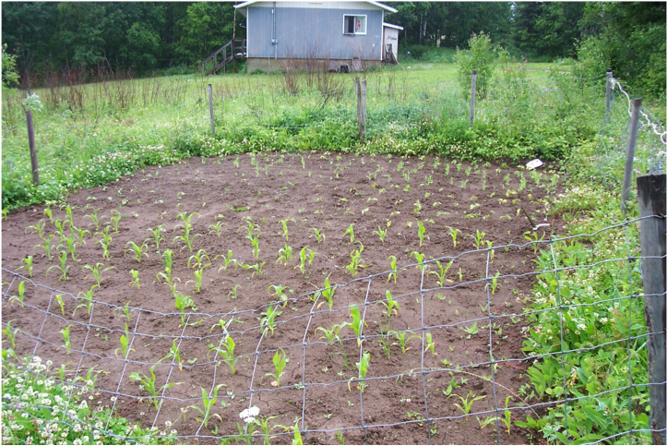
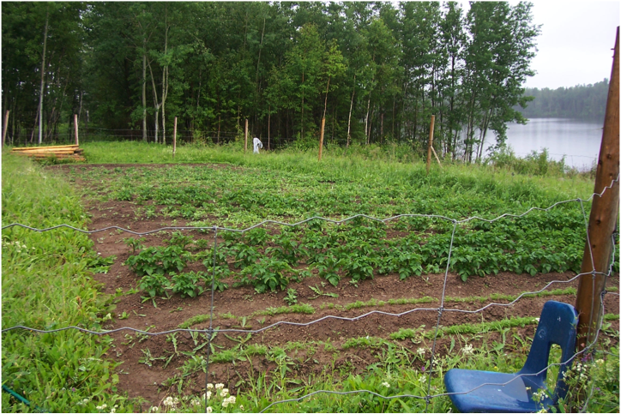
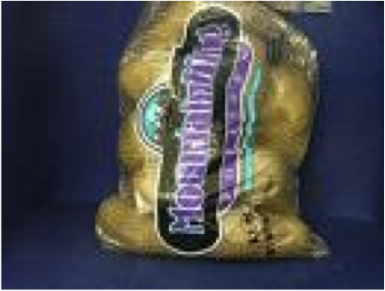
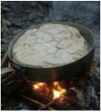
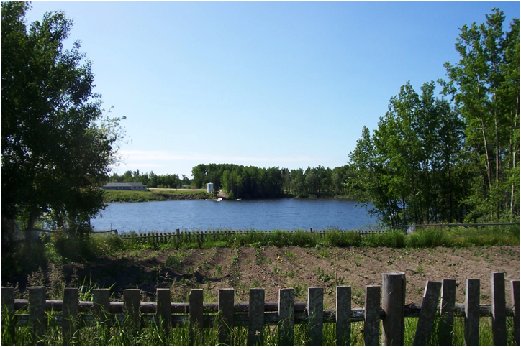
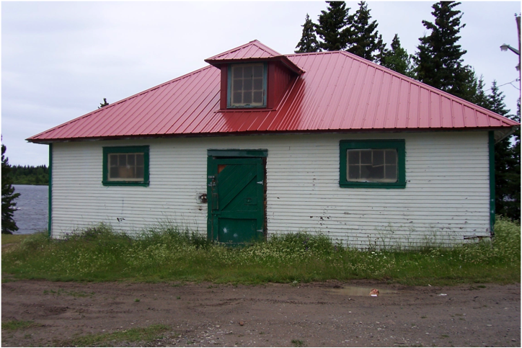
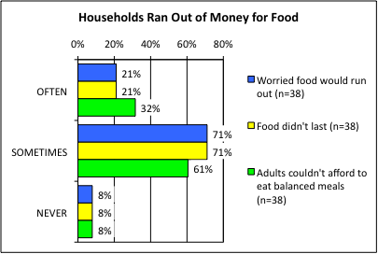
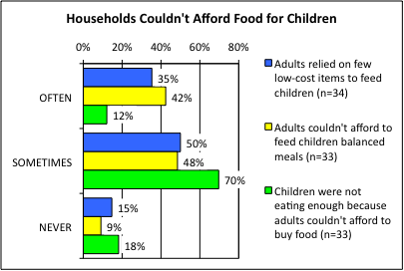
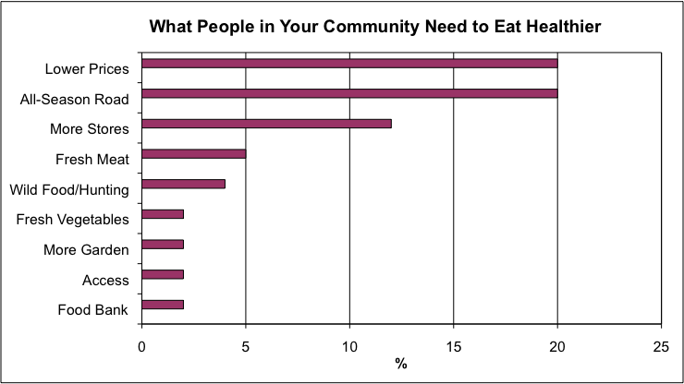
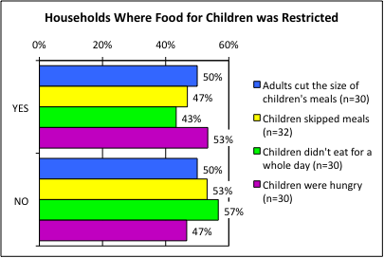
GARDEN HILL FIRST NATION:
Household Food Survey Shows Food Prices are Unaffordable
Shauna Zahariuk, Mariah Mailman and Shirley Thompson
Natural Resources Institute, University of Manitoba
s_thompson@cc.umanitoba.ca
67% of households in Garden Hill eat country food.
A Garden Hill resident said, “produce is sparse and store-bought food is often spoiled [by the time we get it]”.
The largest store near Garden Hill is on Stevenson Island. It costs approximately $8 by water taxi (roundtrip) to get there if you don’t own your own boat.
BACKGROUND
Garden Hill is concerned about the high cost of and lack of access to healthy food. This study found that people living in the north have problems obtaining proper nutrition because they have limited access to healthy food, such as fresh vegetables, fruits, meat, and dairy products. Lack of healthy food access contributes to health problems such as diabetes and obesity.
20% often ran out of money or food and 65% sometimes ran out of food.
SUMMARY OF SURVEY RESULTS
The survey revealed that:
51% of adults ate less than they felt they should, and that 44% of adults were hungry because there was not enough food in the household.
44% of adults reported losing weight because there wasn’t enough money for food, and 43% of adults went without food for a whole day approximately once per month.
Five out of every ten households (53%) reported children were hungry, because there was not enough money for food. Similarly, 50% of children’s meals were smaller than they wanted, because there wasn’t enough food (Figure 5).
Three out of every ten households (43%) of children did not eat for a full day, and 47% of children’s meals were skipped because there wasn’t enough money for food (Figure 5); additionally, children’s meals were often skipped (25%) and sometimes skipped (75%) on a monthly basis.
More than seven out of ten households (77% total with 35% often and 42% sometimes) relied on only a few kinds of low-cost foods to feed children (Figure 4).
More than nine out of ten households (93% total with 32% often and 61% sometimes) could not afford to purchase healthy foods (Figure 3).
OBJECTIVES
This study asked:
Do household members run out of food before they get money to buy more?
Could household members afford to eat balanced meals?
What would people like to see in their community to improve access to healthy food?
What are the barriers to eating healthy in this community?
METHODS
A door to door household food security survey and interviews were conducted in 2009 by Shauna Zahariuk and 41 households out of 436 in the community were surveyed (Manitoba Bureau of Statistics, 2008. 2006 Census Profile, Garden Hill First Nation, IRI). The Health Canada standard method to measure food security rates was applied to compare with Canadian rates, because Health Canada does not collect food security statistics from First Nations. All people interviewed were 18 years and older. The survey findings were analyzed by Statistical Products and Survey Solution (SPSS). Open-ended qualitative interviews were conducted in order to get a holistic understanding of the problem and the solutions. Participatory video was undertaken to record community engagement and your stories.
Figure 3. Households worried money would run out (blue), money did run out (yellow), and they couldn’t afford balanced meals (green).
66% said children weren’t able to eat enough
PROGRAMS AND CONTACTS
Programs are by request, to help actions in communities. Contact for help and supplies:
Northern Healthy Food Initiative (NHFI), Manitoba Government, funds the Bayline Regional Roundtable (BRRT), Four Arrows Regional Health Authority and Manitoba Food Matters to increase access to healthy food and to support food projects. Contacts: Jennell Majeran, Manager (204-677-6677, jennell.majeran@gov.mb.ca) and Jessica Paley (204-945-0569, jessica.paley@gov.mb.ca).
Programs in other communities include:
chicken, turkey (with chicks and chicken food provided but not chicken coop), goat and other small livestock production,
freezer loans for people to buy freezers to store healthy food,
community or school greenhouse and households receiving plastic for building a greenhouse,
provision of vegetable seeds, berry and other bedding plants, and grow lights for schools, and
an annual workshop in Thompson called Northern Harvest to provide free teaching to northern community members about food production and preservation.
2. Manitoba Agriculture, Food and Rural Initiatives (MAFRI) provides gardening support to communities to give workshops on gardening and chicken production. Contact: Brian Hunt (204-856-9255, Fax: 204-745-5690, brian.hunt@gov.mb.ca)
3. Frontier School Division provides Veggie Adventure school activities and greenhouse and gardening expertise for northern climates. Contact: Chuck Stensgard (204-473-2332, chuckstensgard@hotmail.com).
4. Chronic Disease Prevention Initiative (CDPI) provides some funding for traditional activities, gardening and healthy snacks. Contact: Contact: Oberon Munroe, Garden Hill Health Authority (204-465-2343).
5. Four Arrows Regional Health Authority (FARHA) provides a freezer revolving loan program, works with schools and assists with gardening, including providing some seeds and loaning gardening tools and rototiller. Contact Byron Beardy (204-457-2810 or 947-2397, Fax: 204-982-3359, feather204@shaw.ca or farha@mts.net).
6. Apply for Green Team grants that are 100% government funded to employ youth to start community gardens, market gardens or help with household gardening. Fill out the application form at: http:www.edu.gov.mb.ca/youth/employers/hometown.html.
7. Look at the participatory video called “Growing Hope in Northern Manitoba” at: http://home.cc.umanitoba.ca/~thompso4/Movie.html.
FINDINGS
Country food is central to people in Garden Hill and made up 10% to 90% of total foods consumed. The survey revealed that 67% of households either hunted or fished, or received country food from relatives. The survey also showed that 73% of households had a freezer to store country foods, garden produce and store-bought foods.
Freshness, variety, and affordability were reoccurring themes concerning store-bought produce. High costs of foods was the largest barrier to eating healthy (71%), and then freshness of produce (10%). Many people expressed that produce was often wilted or rotten either at purchase time or shortly thereafter.
The survey suggests that the community would like to see an all-season road (20%), which could aid in reducing the costs of foods as people could drive to larger communities and goods could be transported to the community via road. 20% of households identified the need for lower prices of healthy foods so that people can afford them, and 12% said that more stores are needed in Garden Hill.
Figure 4. Households with children relied on a few low-cost food items (blue), couldn’t afford balanced meals (yellow), and weren’t able to eat enough (green). Of the households interviewed, 15% did not have children under 18 years.
43% said children had gone without food for a whole day.
ACKNOWLEDGEMENTS
Funded by Canadian Institutes of Health Research Regional Partnerships Program (CIHR-RPP). We thank to the community of Garden Hill, Linda Manoakeesick, Larry Wood, Four Arrows Regional Health Authority, and Island Lake Lodge.
Figure 5. Households where children’s meals were small (blue), skipped (yellow), children didn’t eat for a whole day (green), and children were hungry but there was no money for food (purple).
Figure 1. What people in your community need to eat healthier.

