Slide 1
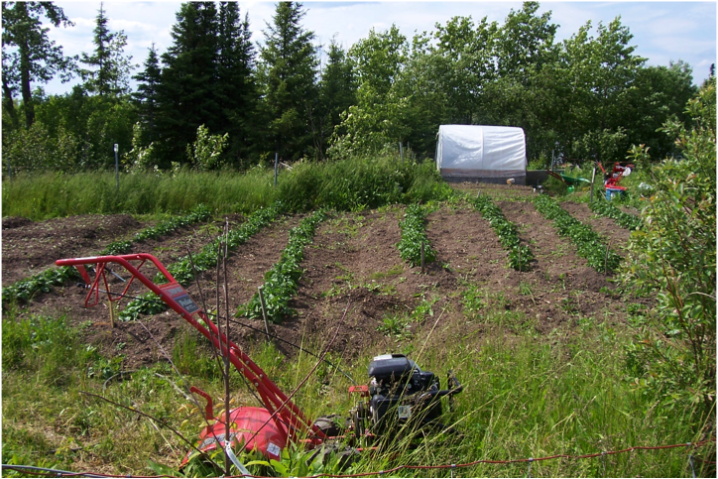
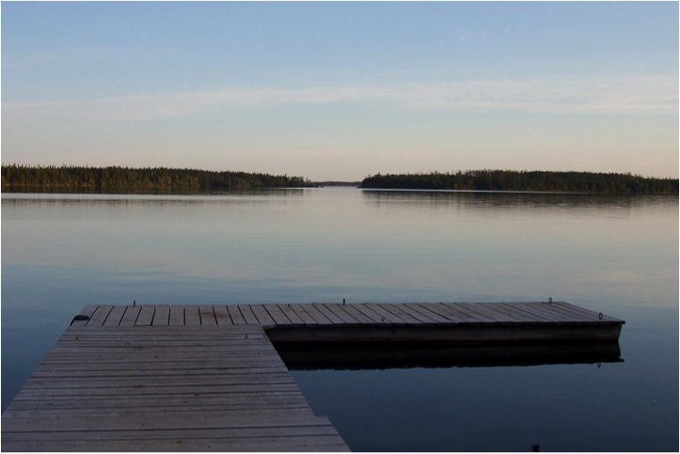
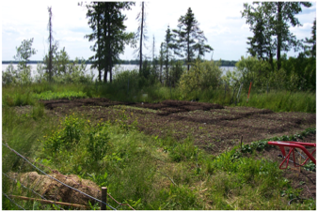
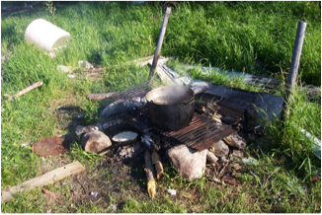
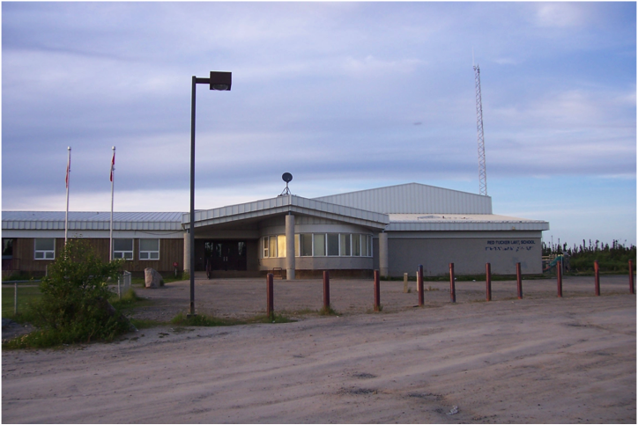
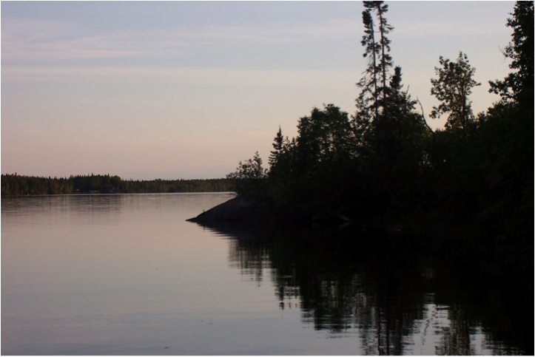
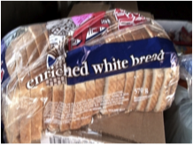
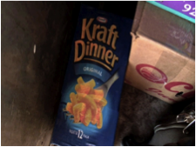
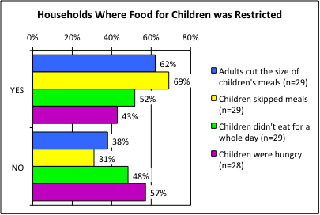
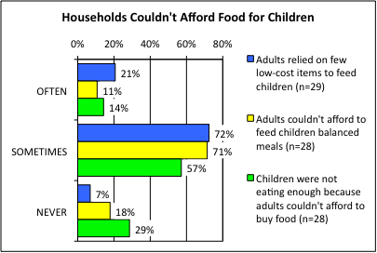
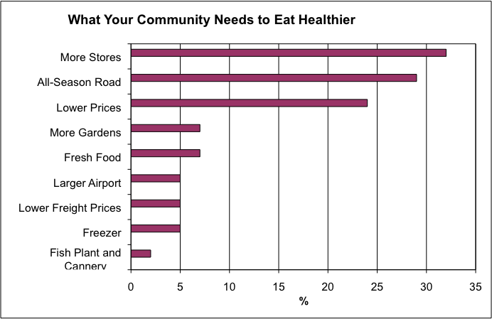
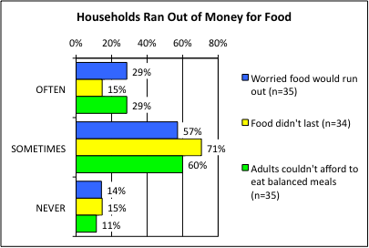
RED SUCKER LAKE FIRST NATION:
Country foods help offset the high cost of food but
more stores and lower prices are needed
Shauna Zahariuk, Mariah Mailman and Shirley Thompson
Natural Resources Institute, University of Manitoba
s_thompson@cc.umanitoba.ca
85% of households in Red Sucker Lake consume country food.
A resident said, “Food on the table is my priority”.
Another resident said, “People with diabetes have a hard time eating right because [food] costs too much”.
Potatoes and carrots are popular crops in Red Sucker Lake.
A Red Sucker Lake resident said, “The price is lowered when the expiry date is past. We have to buy [the food] no matter what, [that is all there is]”.
BACKGROUND
Red Sucker Lake is concerned with the high cost of and lack of access to healthy food. This study found that people living in the North have problems obtaining enough nutritious foods because they have limited access to healthy food, such as fresh vegetables, fruits, meat, and dairy products. Lack of healthy food access contributes to health problems such as diabetes and obesity, as well as other physical disorders.
62% of children’s meals were smaller than they wanted. 52% did not eat for a whole day. 43% were hungry.
SUMMARY OF SURVEY RESULTS
The survey of 40 community households showed that:
43% of households had children that were hungry because there was not enough money for food (Figure 2). Similarly, 62% of children’s meals were smaller than they wanted because there wasn’t enough food.
52% of households with children did not eat for a full day about once per month, and 69% of households had to skip children’s meals because there wasn’t enough money for food (Figure 3).
Households often (11%) and sometimes (71%) could not afford to feed children healthy foods (Figure 3) and 93% (21% often and 72% sometimes) relied on a few low cost items to feed their children.
61% of households had adults that ate less than they felt they should, and 53% of households with adults went hungry because there was not enough food in the home. 86% of adults often (29%) and sometimes (57%) skipped a meal at least once a month due to concern about running out of food.
OBJECTIVES
This study asked:
Did household members run out of food before they got more money to buy more?
Could household members afford to eat balanced meals?
What would people like to see in their community to improve access to healthy food?
What are the barriers to eating healthy in this community?
METHODS
A door to door household food security survey and interviews were conducted in 2009 by Shauna Zahariuk at 40 out of 199 households (Manitoba Bureau of Statistics. 2008. 2006 Census Profile, Red Sucker Lake 1976, IRI). All people interviewed were 18 years and older. The survey findings were analyzed by Statistical Products and Survey Solution (SPSS). Open-ended qualitative interviews were conducted in order to get a holistic understanding of the problem and the solutions. Participatory video was used to record your stories.
Figure 2. Households where children’s meals were small (blue), skipped (yellow), children were hungry but there was no money for food (green), and children didn’t eat for a whole day (purple).
71% sometimes and 11% often couldn’t afford healthy food for children (total: 82%).
PROGRAMS AND CONTACTS
Programs are by request, to help actions in communities. Contact for help and supplies:
Northern Healthy Foods Initiative (NHFI) is a program of the Manitoba Government. NHFI funds the Bayline Regional Roundtable (BRRT), Four Arrows Regional Health Authority (FARHA), Northern Association of Community Councils and Manitoba Food Matters to increase access to healthy food and to support food projects. The NHFI contacts are: Jennell Majeran, Manager (204-677-6677, Jennell.Majeran@gov.mb.ca) and Jessica Paley (204-945-0569, Jessica.Paley@gov.mb.ca).
Programs in other communities include:
chicken, turkey (with chicks and chicken food provided but not chicken coop), goat and other small livestock production,
freezer loans for people to buy freezers to store healthy food,
community or school greenhouse and households receiving plastic for building a greenhouse,
provision of vegetable seeds, berry and other bedding plants, and grow lights for schools, and
an annual workshop in Thompson to provide free teaching to northern community members about food production and preservation.
2. Manitoba Agriculture, Food and Rural Initiatives (MAFRI) provides gardening support to communities to give workshops on gardening and chicken production. Contact: Brian Hunt (204-856-9255, Fax: 204-745-5690, brian.hunt@gov.mb.ca).
3. Frontier School Division provides Veggie Adventure school activities and greenhouse and gardening expertise for northern climates. Contact: Chuck Stensgard (204-473-2332, chuckstensgard@hotmail.com).
4. Chronic Disease Prevention Initiative (CDPI) provides some funding for traditional activities, gardening and healthy snacks. Contact: Fred Harper, Red Sucker Lake Health Authority (204-469-5351)
5. Four Arrows Regional Health Authority (FARHA) provides a freezer revolving loan program, works with schools and assists with gardening, also providing some seeds and loaning gardening tools and a rototiller. Contact: Byron Beardy (204-457-2810 or 947-2397, Fax: 204-982-3359, feather204@shaw.ca or farha@mts.net).
6. Green Team employs youth to start community gardens, market gardens or help with household gardening. This is 100% paid for by government. Fill out form at: http://www.edu.gov.mb.ca/youth/employers/hometown.html.
7. Look at the participatory video called Growing Hope in Northern Manitoba at:
Video Trailer : http://home.cc.umanitoba.ca/~thompso4/Movie.html. (trailer - 8 minutes)
Full length video (22 minutes): http://www.vimeo.com/8114019
FINDINGS
Country food is important to people in Red Sucker Lake and made up 5% to 95% of total foods consumed. The survey revealed that 85% of households either hunted or fished, or received some country food from relatives. The survey also showed that 85% of households had a freezer to store country foods, garden produce and store-bought foods.
The survey suggested that the community would like to see more stores (32%) and an all-season road (29%) that would likely aid in lowering the cost of food, as people could drive to larger communities and goods could be transported to Red Sucker Lake via road (Figure 1). 24% of people identified the need for lower prices in community stores in order to eat healthier.
Freshness, variety, and affordability were reoccurring themes concerning store-bought produce. High cost of food was the largest barrier to eating healthy (63%), and then freshness of produce (33%). Many people expressed that produce was often wilted or rotten either at purchase time or shortly thereafter.
Figure 3. Households with children relied on low-cost food (blue), couldn’t afford healthy foods (red), and weren’t able to eat enough (yellow). Of the households interviewed, 85% had children under 18 years.
71% sometimes and 15% often ran out of food and/or money (total: 86%).
ACKNOWLEDGEMENTS
Funded by Canadian Institutes of Health Research Regional Partnerships Program (CIHR-RPP). We thank the community people of Red Sucker Lake, Byron Beardy, Mark Dourn, Linda Manoakeesick, and Four Arrows Regional Health Authority.
Figure 1. What community people identified as their number one priority to make your community healthier.
Figure 4. Households worried money would run out (blue), money did run out (red), and they couldn’t afford healthy foods (yellow).

