Slide 1
4590 Laboratory
Bioanalytical Chemistry
The plan is to have the student become familiar with working in a Bioanalytical laboratory environment.
The emphasis will be the methodology and instrumentation of the experiment.
This entails both sample preparation and analysis.

Slide 2
4590 Laboratory
Your laboratory write up should be very comprehensive since your mark is 40% of your grade. The grade is determined by the report that you submit.
To be able to write a good laboratory report you will need detailed, understandable laboratory notes. Notes on writing the report are on website.
The notes should be kept in a hardback laboratory notebook. Why?

Slide 3
4590 Laboratory
Consists of 3 experiments, plus a virtual experiment.
The experiments are to be performed during one three hour laboratory period.
The laboratory manuals (on line) should be read and all dilutions and calculation done before the lab. and written in lab. book. You need to be well prepared.
The data needs to be collected during the lab. and e-mailed to yourself.

Slide 4
4590 Laboratory
The experiments may change as problems arise, therefore check website close to your experimental time.
The experimentation should provide the student with a knowledge of the use and capability of certain analytical equipment in a biological laboratory setting.
The student should have theoretical knowledge of the experiment and equipment that they will be doing.

Slide 5
Style
All pre-lab answers and lab reports must be typewritten using word processing software.
The graphs and charts must be plotted using graphical software.
Write in the third person, past tense, do not say I did this or that, instead say this or that was done.
Grammar is important so check your writing.

Slide 6
Copying
Explain things in your own words (with a proper reference for any quotes) to demonstrate your understanding of the idea/subject.
Do not copy the explanation from the lab manual. Any diagrams, schemes, or drawings not created by you must also be referenced.
Each student must submit their own report.

Slide 7
Pre-lab
The purpose of the pre-lab is for you to get a better understanding of your equipment and experiments before coming to the lab.
A pre-lab is required before each of the three experiments and answers must be handed in prior to the beginning of the first lab of a new lab experiment.

Slide 8
Text-Introduction
Introduce your experiment
1) What are you doing, analyzing etc.
Why important
Give some background why the analysis is important what are analysed compounds used for, etc.
Why important to measure them
Give advantages, and limitations of the techniques you are using.

Slide 9
Materials and Methods
) Explain the experimental methods with enough detail that they could be repeated by someone reading your report.
2) List the instruments (including the models and company location) used in your experiment, giving all relevant conditions and settings,
3) You have to presume the person reading your method knows how to run the instrumentation. List any reagents (including manufacturer and grade) used in the experiment, include concentrations, solvents, etc.
4)The material and methods should be in paragraph format or in tables. If tables are used they have to be referred to and explained. They must have divisions and headings.

Slide 10
Results
The results should indicate your findings. Tables and graphs should be used, but they must be introduced and explained. Do not make graphs of table data, do one or the other. Tables or graphs should have headings and the axes should be named. Explanation and table/graph number should be above/ below each table or graph. You can show chromatograms if they are relevant but they must be referred to and explained. Tables and/or graphs have to be cited in the text when they are used in an explanation of results. If drawings are used they should be drawn using software, not drawn by hand. The drawings should be representative of your experiment not some similar material. Show all data used in your calculations and make it obvious for the reader how you’ve arrived at your answer. You normally need only a sample calculation and not all the calculations if they are the same.

Slide 11
Discussion
In the discussion, you discuss your results/observations as they came up in the course of the experiment. You must justify and explain your results. If you did not get the answer you expected explain why. Determine where errors could have occurred and why. Do not blame the equipment unless you can explain or demonstrate your conclusion from another source.
The discussion should have references to other pertinent information from outside sources. If you are trying to explain a result based on an article, you have read, refer to the article and cite it in the references. You should have a number of references besides the textbook. Be precise in your write up. Try to confine the results and discussion part within 4 pages (including tables, graphs etc.) since it is the quality, not quantity that matters.

Slide 12
Conclusions
Conclusions:
The conclusion should be related to the objectives of the experiments. Briefly outline the conclusions drawn from the discussion and highlight any final results. It should be a summary of results found. A paragraph is usually enough.
References:
Give proper references (using a format from a chemical journal) when you take key ideas or information from the text book, journals or any other resources. Give the web address if it is from a standard website. Limit open resources like Wikipedia. You should have a number of references apart from what you are given. Do not cite the lab manual

Slide 13
Lab Reports
Submission of lab reports
You will be submitting one lab report for each experiment for a total of four experiments.
The lab reports are due before the following experiment at the beginning of regular laboratory times. Students must give a notice of at least one day in case they are unable to attend a scheduled experiment or to submit a report on time
The write up will be sent to lab supervisor by e-mail and in PDF format. The lab. and grade will be returned to you by e-mail.

Slide 14
Marking
Lab Report – General Marking Scheme
Pre lab = 2 marks
Introduction = 2.5 marks
Methods and materials = 2.5 marks
Results and discussion = 5 marks each
Conclusions = 1 mark
Closing Questions = 2 marks
  Total of 20 marks

Slide 15
Safety Issues
Labcoat and proper shoes.
Safety glasses when working with chemicals.
Fume hood when toxic chemicals are used. One person at a time.
Wear mask and remain at workstation.
Keep 6 ft. apart from all other personal when possible.

Slide 16
IN THE CASE OF A FIRE ALARM:
Remain calm
if it is safe, evacuate the classroom or lab
go TO THE closest FIRE EXIT
Do not use the elevators
  if you need assistance to evacuate the building, inform YOUR PROFESSOR OR instructor NOW!!!
IF during a building evacuation YOU NEED TO report AN INCIDENT OR A PERSON LEFT BEHIND:
  contact one of the Building FIRE WARDENS OR
  CALL security services 204-474-9341
Do not reenter the building until
  the “all clear” IS DECLARED BY A FIRE WARDEN, security services or the fire Department

Slide 17
Experiments
Experiments for 4590 labs:
Grades will be based on quality, originality of thought and ideas, completeness, accuracy and scientific professionalism of work completed and written up in an approved format.
Three experiments must be run in the 6 week period. You will do 3 of the 4 experiments below plus a virtual experiment.
Exp. 1: Forensic GC experiment
Exp. 2: Enzyme kinetics experiment
Exp. 3: Electrophoresis
Exp. 4: HPLC Method Development Vit. B12
Virtual exp ICP analysis

Slide 18

Forensic GC Experiment
Public perception of forensics laboratory ability becomes somewhat unrealistic

Slide 19

Mobile Lab
Size of laboratory may limit ability to do more than collect samples

Slide 20
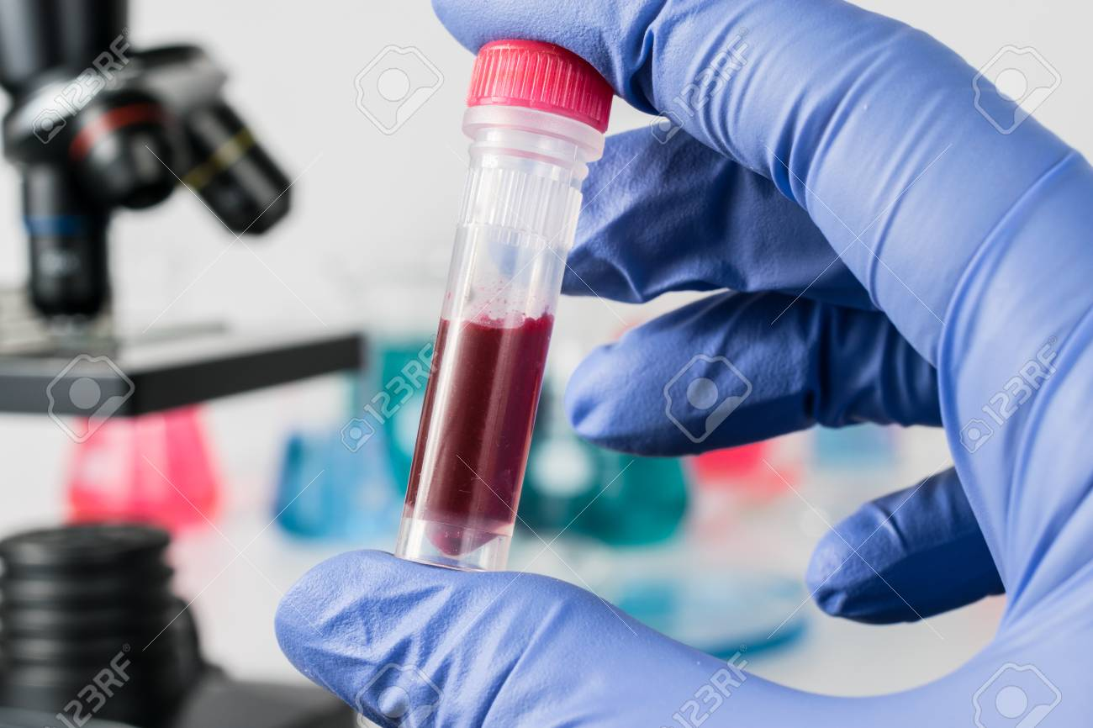
Forensic Experiment
Our Experiment: A possible accidental poisoning
Will measure nicotine and break down products in blood and urine

Slide 21
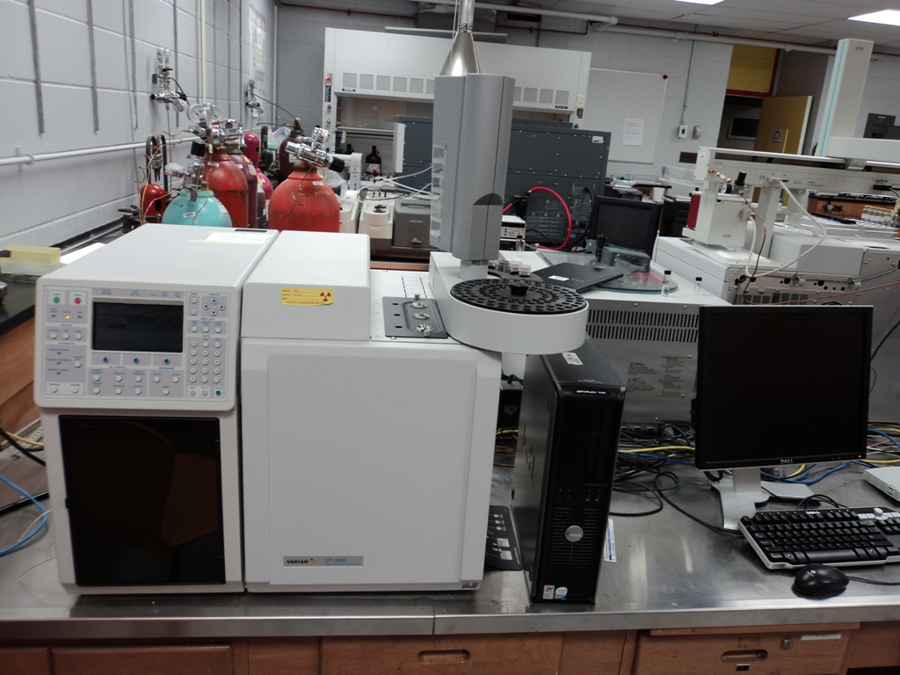
Forensic Exp. Forensic Science is the search for truth and the meaning of evidence in both criminal investigations and through courts of law.
Gas tanks He, N₂, H₂, Air
Autosampler
Detectors
Injectors
Oven
Computer control and data acquisition
What best instruments? Why?

Slide 22
GC-Forensic Experiment
The authorities of a small town are called to what appears as a drug party gone bad. A teenager is found, who is not breathing, at the scene. The teenager is rushed to hospital and could not be revived. At the scene a jar with a liquid is found close to where the teen was located.
In the apartment of one person who also attended the party (a suspect) 20 menthol cigarettes were found in a liquid substance as if the suspect was trying to extract something from the cigarettes. It is believed that the suspect may have extracted nicotine from the cigarettes and mixed the nicotine into an alcohol/water solution to make an amateur drug (poison). This may have been fed to the unsuspecting teen as a drug mixture to obtain a “high”. The partially empty jar held approximately 250 ml. and only about 10 ml. was left in the jar. A sample of the drink (highball) 10 ml. was collected and saved for analysis at the local crime laboratory. The suspected contents were to be analysed using GLC for identification and quantitation.
Urine and blood samples were obtained from the teen approximately 0.5 hours after arrival at the hospital and 1 hours passed before they arrived at the lab. The compounds suspected to be present in the “highball” drink and analysed were nicotine (a very toxic substance), and menthol. If nicotine and menthol are found in the “highball” the source of the poisoning would be confirmed If nicotine plus cotinine are found in the blood and urine of the victim, this would indicate nicotine poisoning presumably from ingestion of the “highball” drink.

Slide 23
What do you need to know?
Time line:
How long person unconscious before they arrived at hospital after ingestion?
How long before analysis?
Weight and gender of person?
Other details??

Slide 24
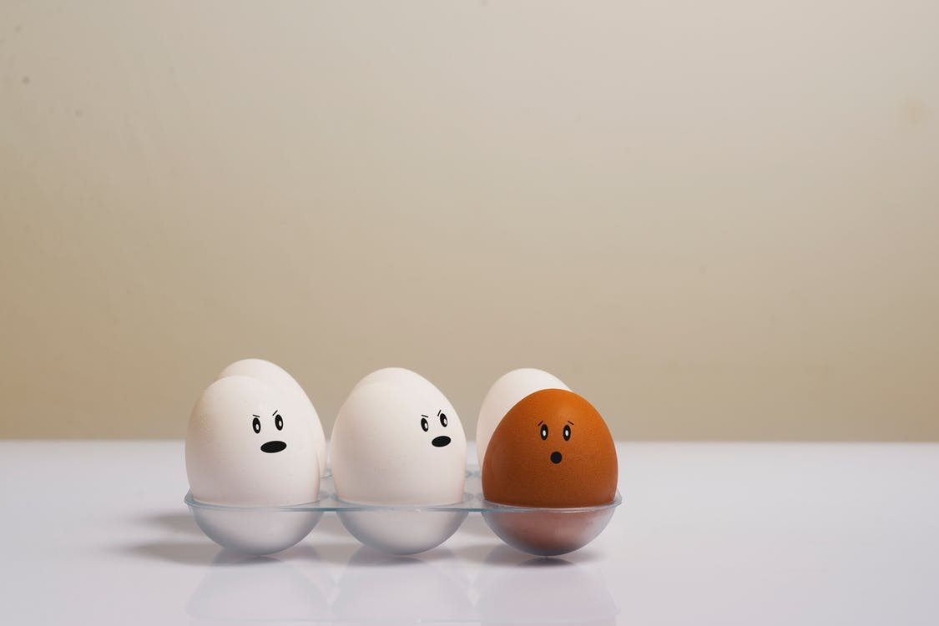
Lysozyme in Eggs
Lysozyme is a glycoside hydrolase that catalyzes the hydrolysis of
1,4-beta-linkages between N-acetylmuramic acid and N-acetyl-D-glucosamine
residues in peptidoglycan, which is the major component of gram-positive
bacterial cell wall.
Breaks bacteria cell : antibiotic properties

Slide 25
Enzyme Kinetics-Lysozyme
Normally in a reaction mixture if the amount of enzyme is kept constant and the substrate concentration is then gradually increased, the reaction velocity will increase until it reaches a maximum.
It is theorized that when this maximum velocity had been reached, all available enzyme has been converted to ES, the enzyme substrate complex. This is the maximum velocity and is designated V_{max}.

Slide 26
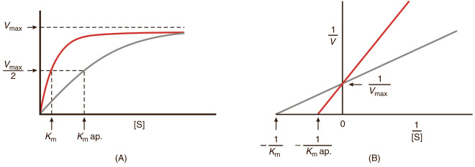
Michaelis Contant and Lineweaver–Burk plot

Slide 27
Maximum velocity
Substrate concentration:
Normally in a reaction mixture if the amount of enzyme is kept constant and the substrate concentration is then gradually increased, the reaction velocity will increase until it reaches a maximum. After this point, increases in substrate concentration will not increase the velocity (∆A/∆t).
It is theorized that when this maximum velocity had been reached, all available enzyme has been converted to ES, the enzyme substrate complex. This is the maximum velocity and is designated V_{max}. Using the maximum velocity and the equation below, Michaelis developed a set of mathematical expressions to calculate enzyme activity in terms of reaction speed from measurable laboratory data.

Slide 28
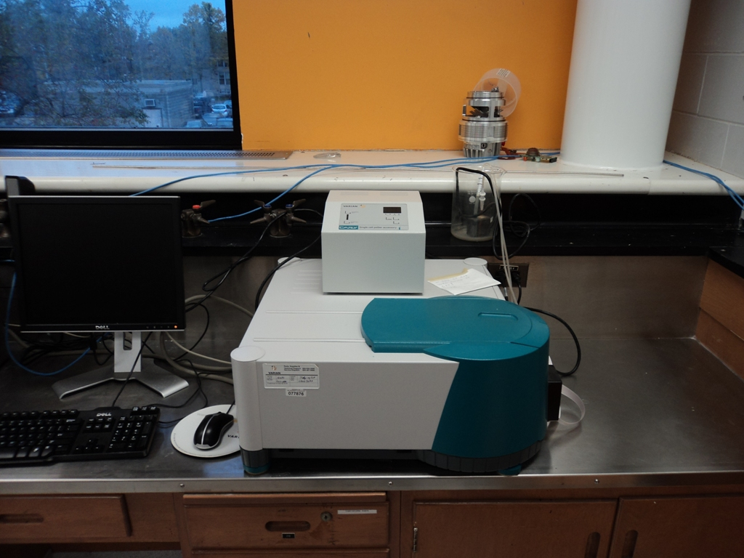
Enzyme Experiment Spectrophotometer

Slide 29
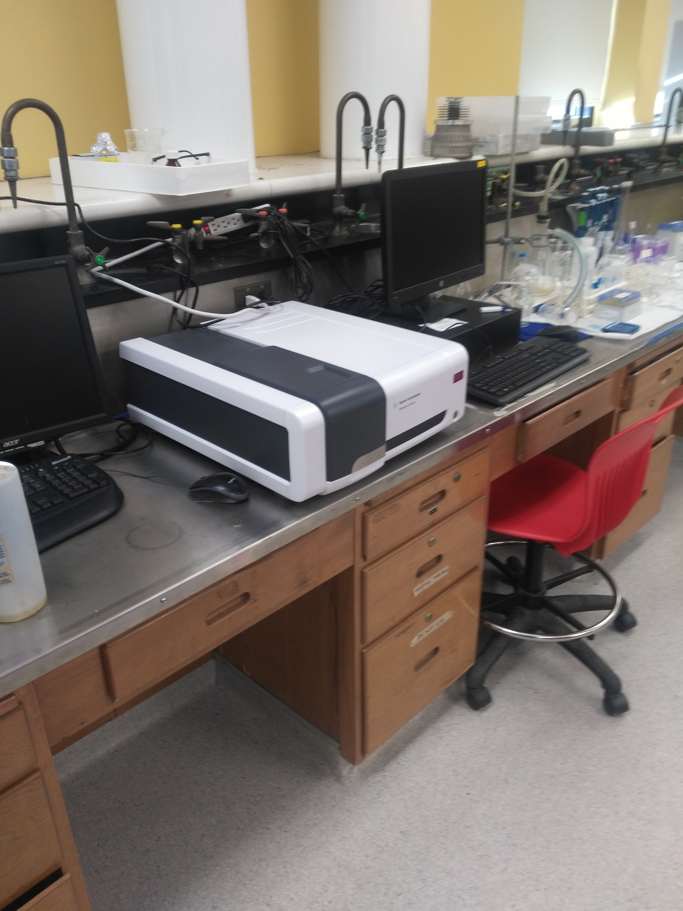

Slide 30
Electrophoresis
Electrophoresis is a commonly used technique in bioanalytical chemistry.
In gel electrophoresis, molecules migrate through a gel medium according to their charge (applied by the electrodes).
In the case of proteins, charge is proportional to mass and therefore molecular weight resolution is achieved.
In the laboratory you will perform electrophoresis of a number of proteins individually and as a mixture.

Slide 31
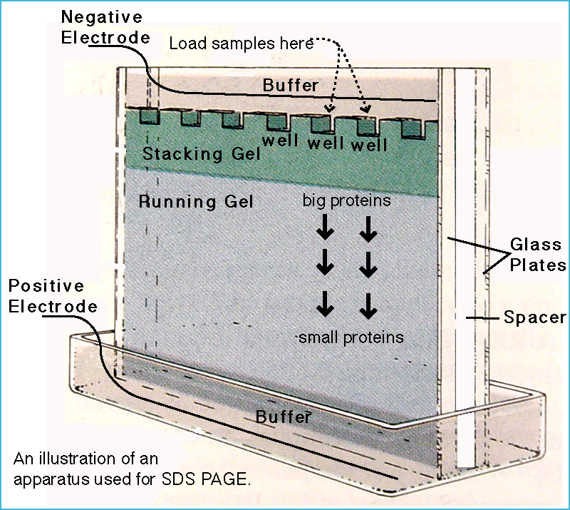

Slide 32
PAGE
A solution of acrylamide and bisacrylamide is polymerized.
The 'pore size' is determined by the ratio of acrylamide to bisacrylamide, and by the concentration of acrylamide.
SDS PAGE
Sodium dodecyl sulfate (SDS) is an amphipathic detergent which binds to proteins,
SDS causes proteins to denature and dissassociate from each other and confers negative charge.
During PAGE, the rate of migration of SDS-treated proteins is effectively determined by molecular weight.

Slide 33
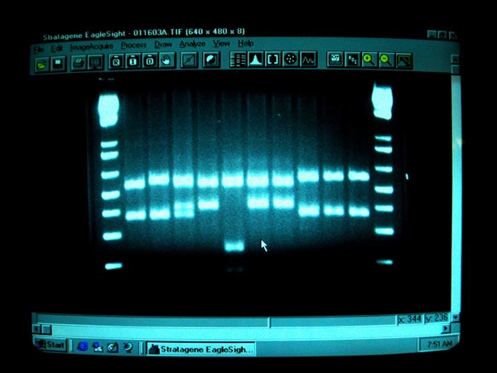
Gel Electrophresis
MW ladders
Protein

Slide 34

Develop HPLC Method

Slide 35
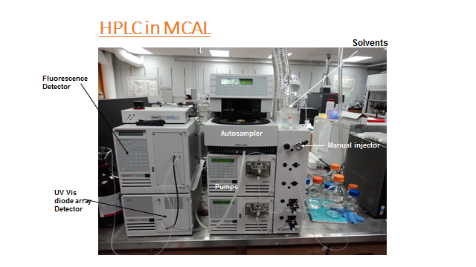

Slide 36
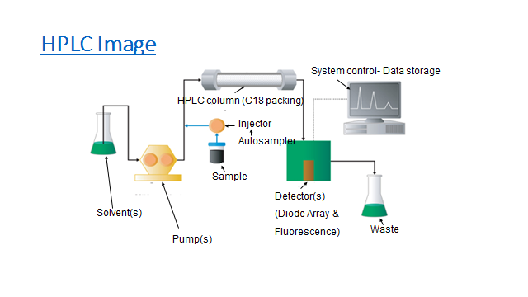

Slide 37
The purpose of this experiment is to develop a HPLC methodology for measuring vitamin B12 in a medication and/or natural product.
You can use either an isocratic system or a gradient. A Vitamin B12 standard is available to use to work out the methodology.
A number of RP HPLC columns are available for you to try.
Vitamin B12 absorption scan will be given to you so you can determine the best wavelength to monitor the absorption of B12.
The HPLC is the Varian Prostar with a diode array detector and a binary pump system.
The reason for your choses for methods sould be a part of your introduction as well as your discussion.

Slide 38
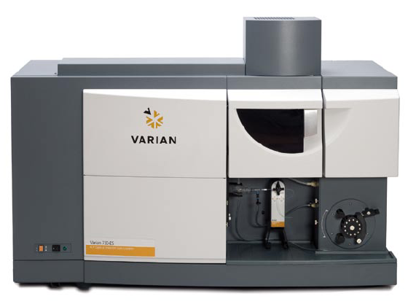
700-ES Series Simultaneous ICP’s
Peristaltic pump
730-ES with SVS-1 switching value system
Notes:
2. The Varian 700ES ICP
• Central controlled by computer
• Uses 32-bit software under Windows operating system
• Fully automated using an autosampler

Slide 39
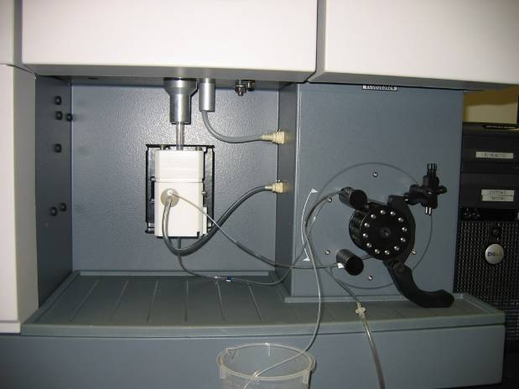
Sample Area - Radial
Peristaltic
pump
Sturman-Masters spray chamber
Argon
Sample
Waste
Notes:
10
10
Sample introduction components of the Varian radial ICP
Peristaltic pump
Nebulizer
Nebulizer pressure regulator and pressure gauge (optional on 720ES series, standard on 710ES series)
Spraychamber – Sturman-Masters shown (low volume glass cyclonic can be used also)

Slide 40
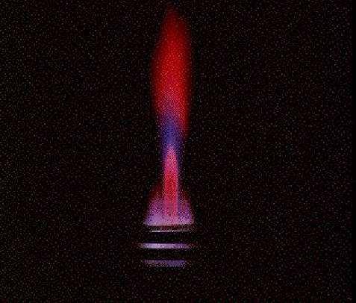
Radial Plasma Torch
Central Channel
Viewing Volume
Fireball
Viewing Height
Work coil
Notes:
Cross section of Radial Torch

Slide 41
The Origin of Emission Lines
Each element possesses a unique, characteristic set of electronic energy levels.
An “excited” atom releases energy in the form of radiation at wavelengths corresponding to the transitions between the different energy levels as they returns to their stable states.

Slide 42
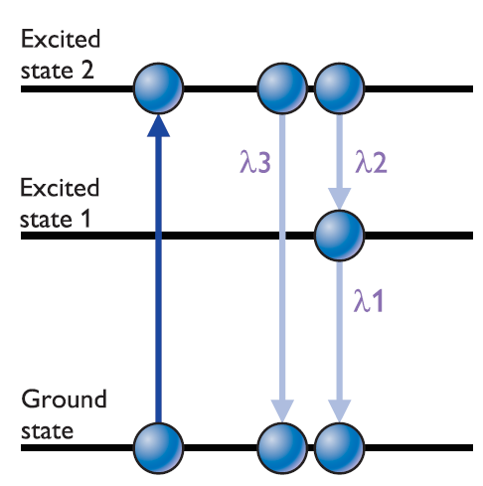
Changing Energy Levels = Emission

Slide 43
Optimization
RF power, viewing height and nebulizer gas flow can be changed individually
There is a resultant change in light intensity and/or light intensity/ background observed.

Slide 44
Viewing Height
The viewing height can be adjusted to minimize the interferences caused by the presence of easily-ionizable elements in the sample matrix.
This is particularly important for solutions containing high levels of Group I and II elements.

Slide 45
RF Power
High power settings will increase the intensity of the HARD lines because the higher temperature in the plasma will promote the high energy transitions.
The intensity of SOFT lines, generally do not increase significantly with higher powers because they correspond to low energy transitions and therefore are already near their maximum sensitivity at lower powers.
Notes:
The background also tends to rise with higher power. The extent of this increase will depend on the wavelength, with the greater increase at higher wavelengths. It is important to monitor the effect on background because, depending on the wavelength, an increase in the measured signal with higher power may only be due to an increase in the background and not necessarily to a net increase in analyte signal. This is often the case with soft lines (e.g., K 766.491 nm, Na 589.592 nm) and optimizing for signal-to-background ratio will usually produce the best conditions for measuring trace levels of these analyte types.

Slide 46
Nebulizer Pressure/Flow
The nebulizer gas pressure (for regulated nebulizer gas) or nebulizer gas flow (for mass flow controlled nebulizer gas) is a critical parameter that can significantly enhance the intensity of selected lines.
The intensity of HARD lines can be increased significantly by reducing the nebulizer gas pressure/flow. Reducing the nebulizer gas pressure/flow effectively increases the temperature in the central channel, which favours the high energy transitions.
The optimum intensity of SOFT lines, on the other hand, is achieved at the low temperature conditions resulting from the higher nebulizer pressures/flows. A compromise nebulizer gas pressure/flow, weighted in favor of the lines requiring the maximum intensity, should be set for an analytical method that contains both HARD and SOFT lines.

Slide 47
PLASMA
A plasma is an electrically conductive gas containing charged particles. When atoms of a gas are excited to high energy levels, the atoms loose hold of some of their electrons and become ionised producing a plasma containing electrically charged particles - ions and electrons.

Slide 48
Sample Preparation for ICP

Slide 49
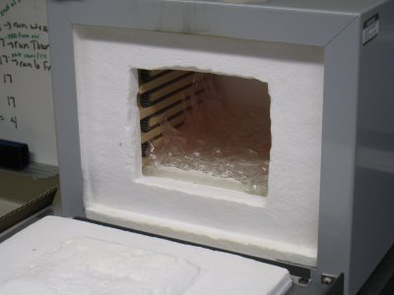
Sample Preparation
ICP Analysis
Solid samples are usually prepared by means of wet ashing or dry ashing.
Dry ashing involves burning off organics in high temperature oven. Dissolving ash in strong acid (nitric, aqua regia, hydrochloric, perchloric or sulfuric).
Muffle furnace 600ºC
Notes:
Samples are weighed into porcelin or other containers and ashed at high temperature to burn off the organic material and leave only the ash. The ash is then dissolved on hot plate in strrong nitric acid, aqua regia or other acid combinations.

Slide 50
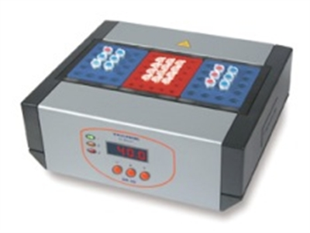
Wet Ashing
Wet ashing involves digesting whole sample in strong acid.
Digestion can be by digestion block or microwave.
Samples in racks
Block heater temperature controlled

Slide 51
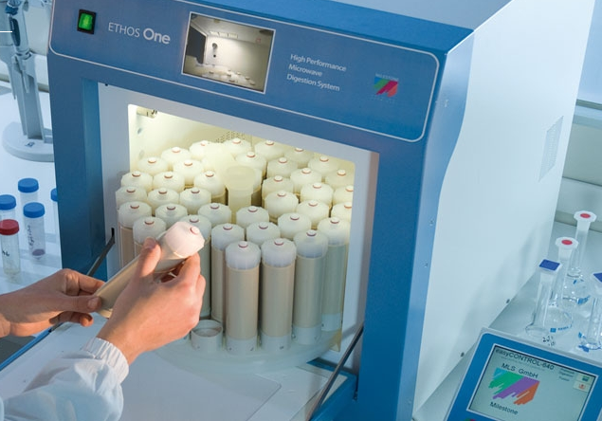
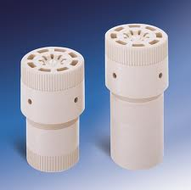
Microwave Digestion
Microwave digestion can be by closed vessel digestion at high pressure and temperature
Notes:
The closed cells are usually made of an inert material like nylon and usually are quite expensive.

